Slide 1



Bayesian Graphical Modeling
The Bayesian Approach to Network Psychometrics
Bayesian Methods for the Social Sciences II
m.marsman@uva.nl
bayesiangraphicalmodeling.com

Slide 2
Session Material
https://bayesiangraphicalmodeling.com/workshops/

Slide 3

Session setup
Part I: Context
image: Flaticon.com

Slide 4

Session setup
Part I: Context
Part II: Theory
image: Flaticon.com

Slide 5

Session setup
Part I: Context
Part II: Theory
Part III: Tutorial
image: Flaticon.com

Slide 6


Session setup
Part I: Context
Part II: Theory
Part III: Tutorial
Part IV: Practical
image: Flaticon.com

Slide 7
Session setup
Part I: Context
image: Flaticon.com

Slide 8
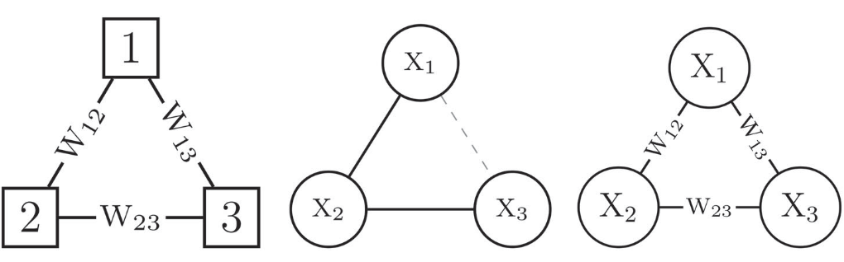
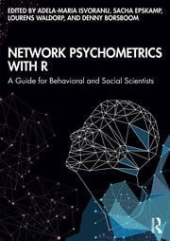
What is network psychometrics?
X
X
θ
X
Network modeling in psychology
X
X
X
Networks, random graphs, and graphical models
Network analysis in psychology

Slide 9
What is network psychometrics?
X
X
θ
X
Network modeling in psychology
X
X
X
Networks, random graphs, and graphical models
Network analysis in psychology

Slide 10
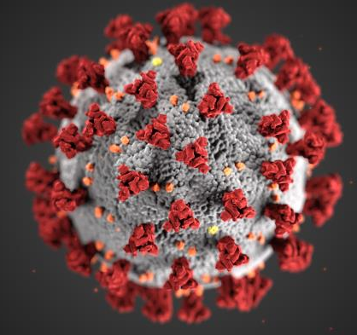
Latent variable model vs graphical model
Disease analogy
X₁
θ
X₂
X₃
Latent variable model

Slide 11
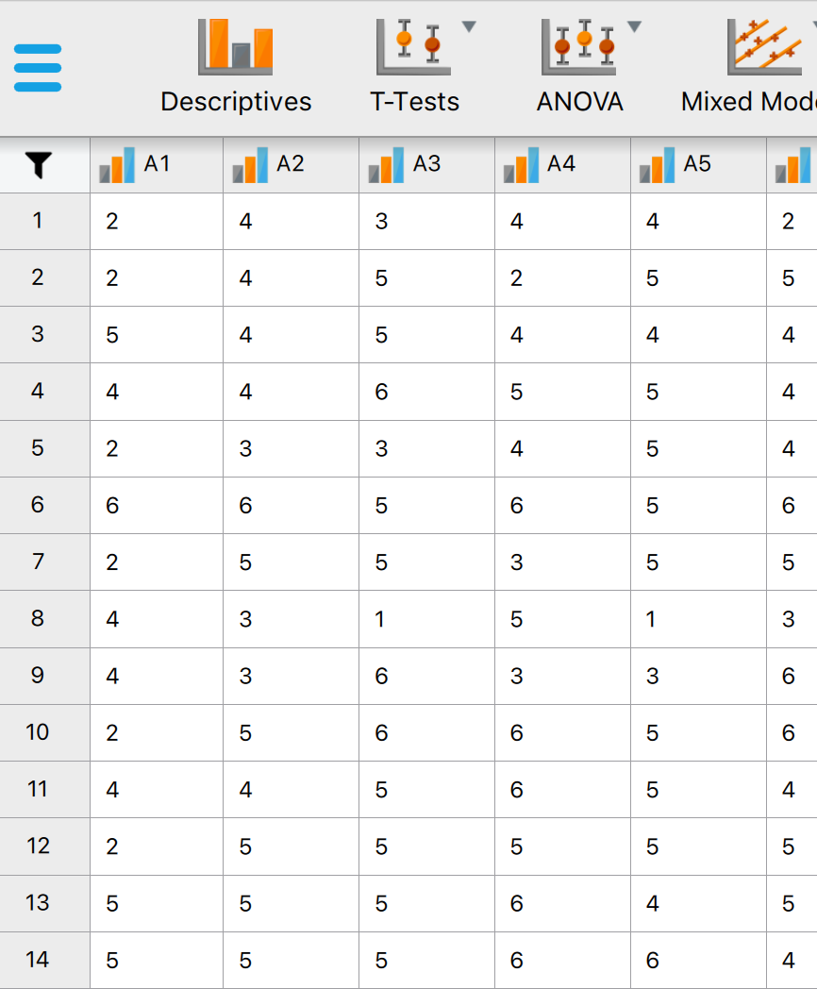
Latent variable model vs graphical model
Disease analogy
Psychological data
X₁
θ
X₂
No conclusive evidence for single cause
X₃
Latent variable model

Slide 12
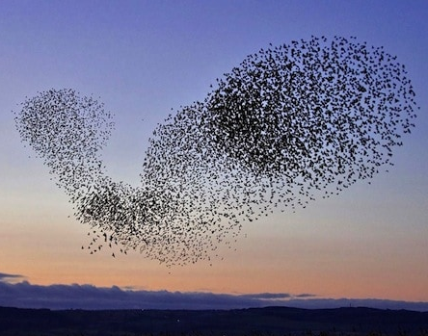
Latent variable model vs graphical model
Disease analogy
Psychological data
Flocking analogy
X₁
X₂
θ
X₂
No conclusive evidence for single cause
X₁
X₃
X₃
Latent variable model
Graphical model

Slide 13
Distinct theory, but equivalent statistical models
X₂
X₁
θ
X₂
X₁
X₃
X₃

Slide 14
Distinct theory, but equivalent statistical models
X₂
X₁
θ
X₂
X₁
X₃
X₃
Model fit is insufficient to explain the data generating mechanism

Slide 15
Further reading
Marsman, M., Borsboom, D., Kruis, J., Epskamp, S., van Bork, R., Waldorp, L., van der Maas, H. & Maris, G. (2018). An introduction to network psychometrics: Relating Ising network models to item response theory models. Multivariate Behavioral Research, 53, 15-35.
Marsman, M., & Rhemtulla, M. (2022). Guest Editors’ introduction to the special issue “Network Psychometrics in Action”: Methodological innovations inspired by empirical problems. Psychometrika, 87, 1-11.
Waldorp, L. J., & Marsman, M. (2022). Relations between networks, regression, partial correlation, and latent variable models. Multivariate Behavioral Research, 57, 994-1006.

Slide 16
What is network psychometrics?
X
X
θ
X
Network modeling in psychology
X
X
X
Networks, random graphs, and graphical models
Network analysis in psychology

Slide 17
What is network psychometrics?
X
X
θ
X
Network modeling in psychology
X
X
X
Networks, random graphs, and graphical models
Network analysis in psychology

Slide 18
What is network psychometrics?
X
X
θ
X
Network modeling in psychology
X
X
X
Networks, random graphs, and graphical models
Network analysis in psychology

Slide 19
Networks, random graphs, and graphical models
THESE PEOPLE ARE NOT NETWORK PEOPLE!!
-Reviewer 2-

Slide 20
Networks, random graphs, and graphical models

Slide 21
Networks, random graphs, and graphical models
Random graph models
(relations are random variables)

Slide 22
Networks, random graphs, and graphical models
Graphical models
(nodes are random variables)

Slide 23
Networks, random graphs, and graphical models
Encompassing network model
(nodes and relations are random variables)

Slide 24
Networks, random graphs, and graphical models
Node marginal

Slide 25
Networks, random graphs, and graphical models
Edge marginal

Slide 26
Networks, random graphs, and graphical models
Network Models

Slide 27
Networks, random graphs, and graphical models
Graphical models
(nodes are random variables)

Slide 28
Networks, random graphs, and graphical models
Random graph models
(relations are random variables)

Slide 29
Further reading
Fortuin, C., & Kasteleyn, P. (1972). On the Random-Cluster model: I. Introduction and relation to other models. Physica, 57, 536–564.
Häggström, O. (2001). Coloring percolation clusters at random. Stochastic Processes and their Applications, 96, 213–242.
Marsman, M., & Huth, K. (2023). Idiographic Ising and Divide and Color Models: Encompassing networks for heterogeneous binary data. Multivariate Behavioral Research, 58, 787-814.
Marsman, M., Waldorp, L., & Borsboom, D. (2023). Towards an Encompassing Theory of Network Models: Reply to Brusco, Steinley, Hoffman, Davis-Stober, & Wasserman. Psychological Methods, 28, 757-764.

Slide 30
What is network psychometrics?
X
X
θ
X
Network modeling in psychology
X
X
X
Networks, random graphs, and graphical models
Network analysis in psychology

Slide 31
What is network psychometrics?
X
X
θ
X
Network modeling in psychology
X
X
X
Networks, random graphs, and graphical models
Network analysis in psychology

Slide 32
What is network psychometrics?
X
X
θ
X
Network modeling in psychology
X
X
X
Networks, random graphs, and graphical models
Network analysis in psychology

Slide 33
Network estimation
Available methods
Frequentist
Semi-Bayesian (i.e., regularization)
Bayesian

Slide 34
Model Selection
Available methods
Frequentist (i.e., AIC, BIC, etc.)
Semi-Bayesian (empirical Bayes)
Bayesian (Bayes factor)

Slide 35
Model Selection
Testing
Cross-Sectional: Conditional independence
Longitudinal: Granger causality
Available methods
Frequentist (i.e., AIC, BIC, etc.)
Semi-Bayesian (empirical Bayes)
Bayesian (Bayes factor)

Slide 36
Edge configuration uncertainty is huge!
sleep
prob.
concen-
tration
prob.
loss of
interest
tired-
ness
psycho-
motor
prob.
suicidal
ideation
loss of
appetite
reduced
selfworth
depr.
mood

Slide 37
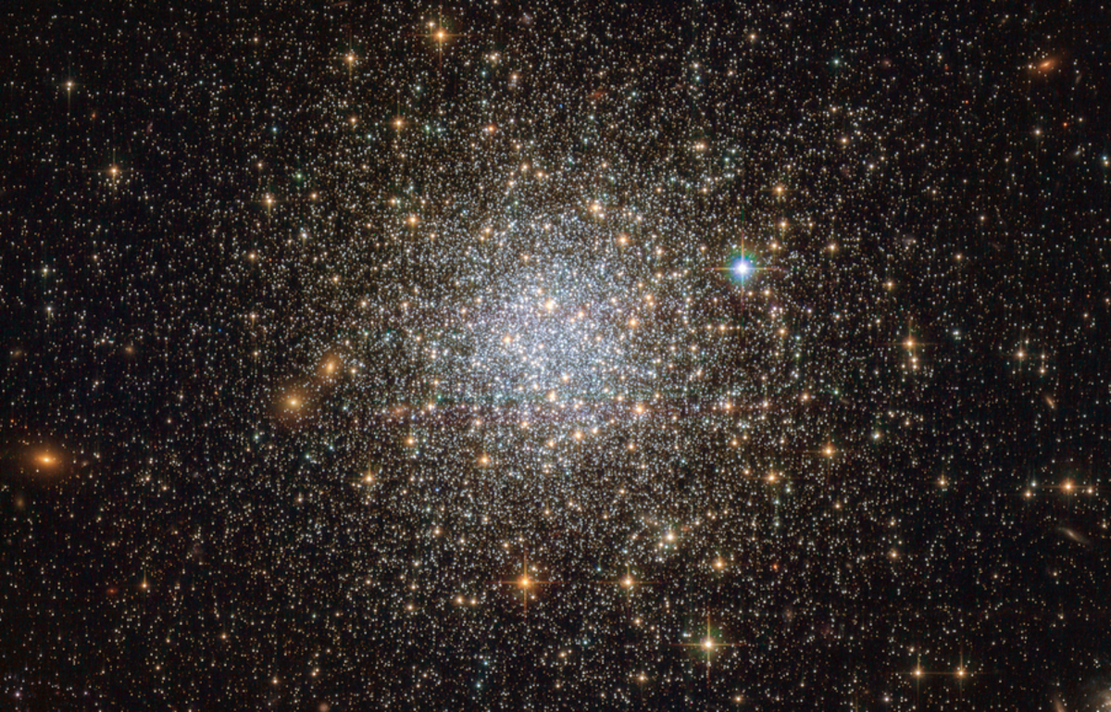
Edge configuration uncertainty is huge!
sleep
prob.
concen-
tration
prob.
loss of
interest
tired-
ness
psycho-
motor
prob.
suicidal
ideation
loss of
appetite
reduced
selfworth
depr.
mood

Slide 38
Edge configuration uncertainty is huge!
sleep
prob.
concen-
tration
prob.
loss of
interest
tired-
ness
psycho-
motor
prob.
suicidal
ideation
loss of
appetite
reduced
selfworth
depr.
mood

Slide 39

Edge configuration uncertainty is huge!
Personal conviction:
Model selection in network psychometrics is useless.

Slide 40
Further reading
Blanken, T., Isvoranu, A.-M., & Epskamp, S. (2022). Estimating network structures using model selection. In A.-M. Isvoranu, S. Epskamp, L. Waldorp, & D. Borsboom (Eds.), Network Psychometrics with R. Routledge.
Oravecz, Z., & Vandekerckhove, J. (in press). Quantifying Evidence for—and against—Granger Causality with Bayes Factors. Multivariate Behavioral Research.
Sekulovski, N., Keetelaar, S., Huth, K., Wagenmakers, E.-J., van Bork, R., van den Bergh, D., & Marsman, M. (in press). Testing conditional independence in psychometric networks: An analysis of three Bayesian methods. Multivariate Behavioral Research.
Williams, D., Rhemtulla, M., Wysocki, A., & Rast, P. (2019). On nonregularized estimation of psychological networks. Multivariate Behavioral Research, 54, 719–750.

Slide 41

End of Part I
Part I: Context
Part II: Theory
image: Flaticon.com

